Slide 1
Chapter 7
Random-Number Generation
Banks, Carson, Nelson & Nicol
Discrete-Event System Simulation

Slide 2
Purpose & Overview
Discuss the generation of random numbers.
Introduce the subsequent testing for randomness:
  Frequency test
  Autocorrelation test.

Slide 3
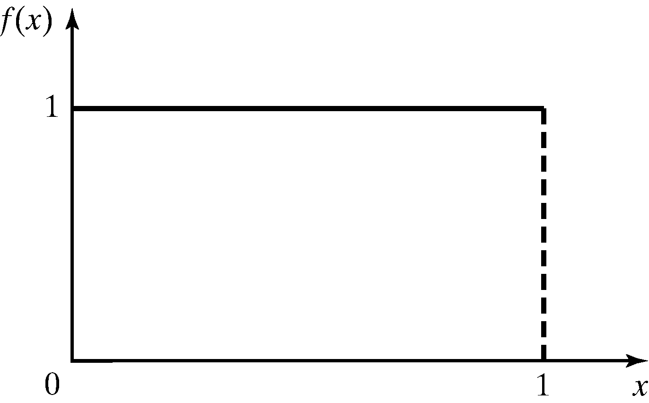
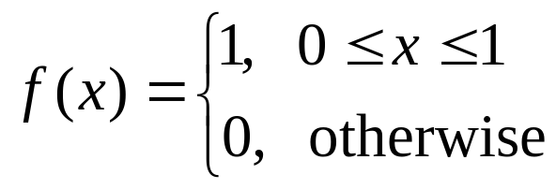
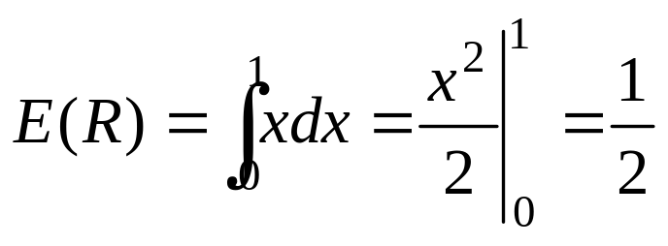
Properties of Random Numbers
Two important statistical properties:
  Uniformity
  Independence.
Random Number, R_{i}, must be independently drawn from a uniform distribution with pdf:
Figure: pdf for random numbers

Slide 4
Generation of Pseudo-Random Numbers
“Pseudo”, because generating numbers using a known method removes the potential for true randomness.
Goal: To produce a sequence of numbers in [0,1] that simulates, or imitates, the ideal properties of random numbers (RN).
Important considerations in RN routines:
  Fast
  Portable to different computers
  Have sufficiently long cycle
  Replicable
  Closely approximate the ideal statistical properties of uniformity and independence.

Slide 5
Techniques for Generating Random Numbers
Linear Congruential Method (LCM).
Combined Linear Congruential Generators (CLCG).
Random-Number Streams.

Slide 6

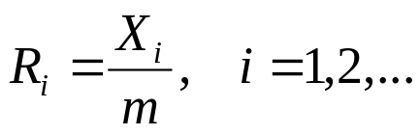
Linear Congruential Method [Techniques]
To produce a sequence of integers, X₁, X₂, … between 0 and m-1 by following a recursive relationship:
The selection of the values for a, c, m, and X₀ drastically affects the statistical properties and the cycle length.
The random integers are being generated [0,m-1], and to convert the integers to random numbers:
The multiplier
The increment
The modulus

Slide 7

Types of Linear Congruential Generator
Mixed (when c is non zero)
Multiplicative (when c is zer0)

Slide 8
Example [LCM]
Use X₀ = 27, a = 17, c = 43, and m = 100.
The X_{i} and R_{i} values are:
  X₁ = (17*27+43) mod 100 = 502 mod 100 = 2, R₁ = 0.02;
  X₂ = (17*2+43) mod 100 = 77, R₂ = 0.77;
  X₃ = (17*77+43) mod 100 = 52, R₃ = 0.52;
  …

Slide 9
Characteristics of a Good Generator [LCM]
Maximum Density
  Such that he values assumed by R_{i}, i = 1,2,…, leave no large gaps on [0,1]
  Ex - Set {1,5,9,13,17,21,25,29,33,37,41,45,49,53,57,61}
  Problem: Instead of continuous, each R_{i} is discrete
  Solution: a very large integer for modulus m
    Approximation appears to be of little consequence
Maximum Period
  To achieve maximum density and avoid cycling.
  Achieve by: proper choice of a, c, m, and X₀.
Most digital computers use a binary representation of numbers
  Speed and efficiency are aided by a modulus, m, to be (or close to) a power of 2.

Slide 10
Combined Linear Congruential Generators [Techniques]
Reason: Longer period generator is needed because of the increasing complexity of stimulated systems.
Approach: Combine two or more multiplicative congruential generators.
Let X_{i,1}, X_{i,2}, …, X_{i,k}, be the i^{th} output from k different multiplicative congruential generators.
  The j^{th} generator:
    Has prime modulus m_{j} and multiplier a_{j} and period is m_{j-1}
    Produces integers X_{i,j} is approx ~ Uniform on integers in [1, m-1]
    W_{i,j} = X_{i,j} -1 is approx ~ Uniform on integers in [1, m-2]

Slide 11
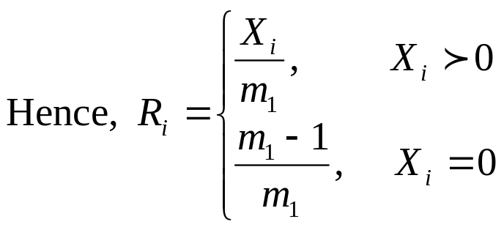
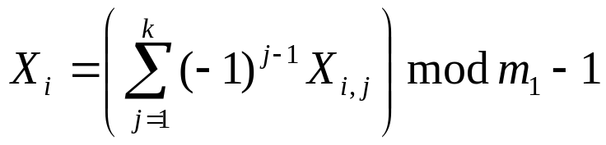
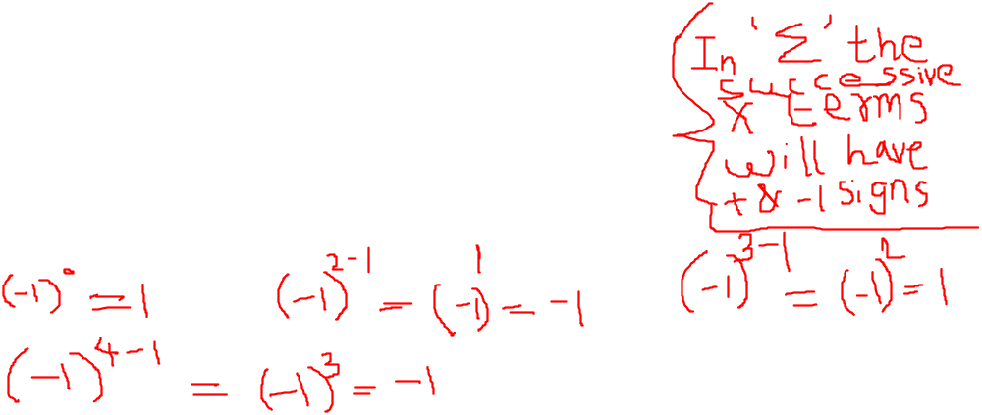
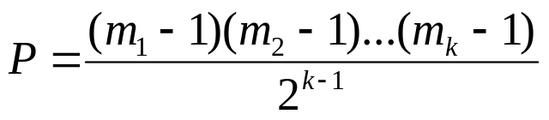
Combined Linear Congruential Generators [Techniques]
  Suggested form:
    The maximum possible period is:
The coefficient: Performs the subtraction X_{i,1-1}

Slide 12
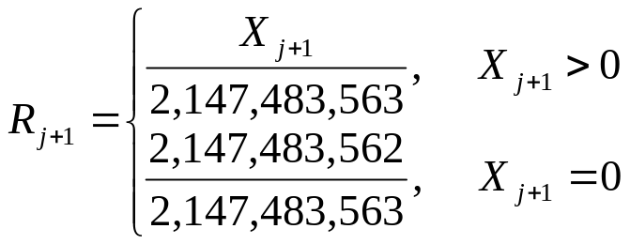
Combined Linear Congruential Generators [Techniques]
Example: For 32-bit computers, L’Ecuyer [1988] suggests combining k = 2 generators with m₁ = 2,147,483,563, a₁ = 40,014, m₂ = 2,147,483,399 and a₂ = 20,692. The algorithm becomes:
  Step 1: Select seeds
    X_{1,0} in the range [1, 2,147,483,562] for the 1st generator
    X_{2,0} in the range [1, 2,147,483,398] for the 2nd generator.
    Step 2: For each individual generator,
    X_{1,j+1} = 40,014 X_{1,j} mod 2,147,483,563
    X_{2,j+1} = 40,692 X_{1,j} mod 2,147,483,399.
  Step 3: X_{j+1} = (X_{1,j+1} - X_{2,j+1} ) mod 2,147,483,562.
  Step 4: Return
  Step 5: Set j = j+1, go back to step 2.
  Combined generator has period: (m₁ – 1)(m₂ – 1)/2 ~ 2 x 10¹⁸

Slide 13
Example on Combined congruential Generator Exercise No 16 from Text Book
L’Ecuyer provides a generator that combines three multiplicative generators, with a₁=157, m₁=32,363, a₂=146,m₂=31,727, a₃=142 and m₃=31,657. Generate 5 random numbers with the combined generator, using the initial seeds X_{1,0}=100, X_{2,0}=300 & X_{3,0}= 500 for the individual generators.
Solution: Next seed = X₁
k=3 and m₁=32,363

Slide 14
The calculation of seeds X_{1,1} X_{2,1} & X_{3,1}
For 2nd generator
Calculation of X_{2,1}
X_{2,1}= a₂ * X_{2,0} mod m2
=146 * 300 mod 31727
= mod 31727
= 12073
For 3rd generator
Calculation of X_{3,1}
X_{3,1}= a₃ * X_{3,0} mod m3
=142 * 500 mod 31657
= 71000 mod 31657
=7686
For First generator
Calculation of X_{1,1}
X_{1,1}= a₁ * X_{1,0} mod m1
=157 * 100 mod 32363
= 15700 mod 32363
= 15700
X₁= (X_{1,1} - X_{2,1} + X_{3,1} ) mod (m₁-1)
= (15700-12073+7686) mod 32662
= 11313
R1= X₁/m₁=11313/ 32363 = 0.3496
Similarly Calculate X2, R2,X3,R3 X4,R4 & X5,R5
Using X_{1,1} X_{2,1} & X_{3,1}

Slide 15
Calculations of X2, R2
X_{1,2} = 5312
X_{2,2} = 17673
X_{3,2} = 15074
X₂ = 2713
R₂ = 0.0838
X_{1,3} = 24909
X_{2,3} = 10371
X_{3,3} = 19489
X3 = 1665
R3 = 0.0515
X_{1,4} = 27153
X_{2,4} = 22997

Slide 16

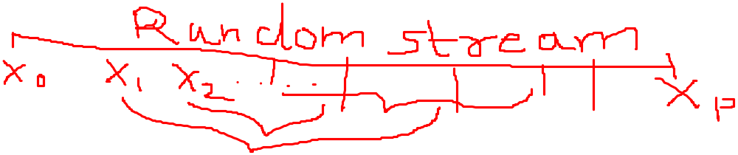
Random-Numbers Streams [Techniques]
The seed for a linear congruential random-number generator:
  Is the integer value X₀ that initializes the random-number sequence.
  Any value in the sequence can be used to “seed” the generator.
A random-number stream:
  Refers to a starting seed taken from the sequence X₀, X₁, …, X_{P.}
  If the streams are b values apart, then stream i could defined by starting seed:
  Older generators: b = 10⁵; Newer generators: b = 10³⁷.
A single random-number generator with k streams can act like k distinct virtual random-number generators
To compare two or more alternative systems.
  Advantageous to dedicate portions of the pseudo-random number sequence to the same purpose in each of the simulated systems.

Slide 17
Tests for Random Numbers
Two categories:
  Testing for uniformity:
  H₀: R_{i} ~ U[0,1]
  H₁: R_{i} ~ U[0,1]
    Failure to reject the null hypothesis, H₀, means that evidence of non-uniformity has not been detected.
  Testing for independence:
  H₀: R_{i} ~ independently
  H₁: R_{i} ~ independently
    Failure to reject the null hypothesis, H₀, means that evidence of dependence has not been detected.
Level of significance α, the probability of rejecting H₀ when it is true: α = P(reject H₀|H₀ is true)
/
/

Slide 18
Tests for Random Numbers
When to use these tests:
  If a well-known simulation languages or random-number generators is used, it is probably unnecessary to test
  If the generator is not explicitly known or documented, e.g., spreadsheet programs, symbolic/numerical calculators, tests should be applied to many sample numbers.
Types of tests:
  Theoretical tests: evaluate the choices of m, a, and c without actually generating any numbers
  Empirical tests: applied to actual sequences of numbers produced. Our emphasis.

Slide 19
Frequency Tests [Tests for RN]
Test of uniformity
Two different methods:
  Kolmogorov-Smirnov test
  Chi-square test

Slide 20

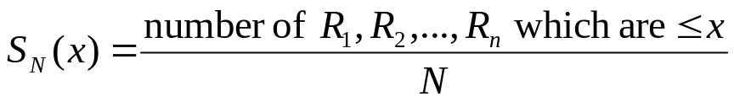
Kolmogorov-Smirnov Test [Frequency Test]
Compares the continuous cdf, F(x), of the uniform distribution with the empirical cdf, S_{N}(x), of the N sample observations.
  We know:
  If the sample from the RN generator is R₁, R₂, …, R_{N}, then the empirical cdf, S_{N}(x) is:
Based on the statistic: D = max| F(x) - S_{N}(x)|
  Sampling distribution of D is known (a function of N, tabulated in Table A.8.)
A more powerful test, recommended.

Slide 21
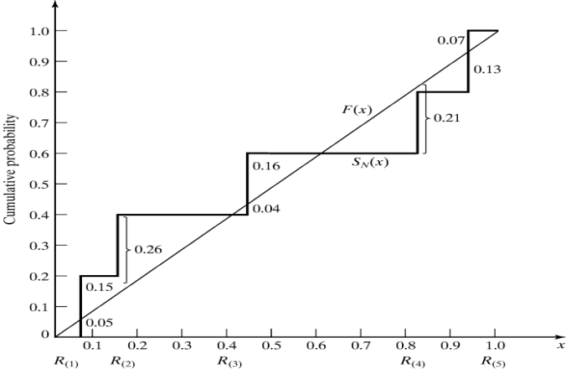
Kolmogorov-Smirnov Test [Frequency Test]
Example: Suppose 5 generated numbers are 0.44, 0.81, 0.14, 0.05, 0.93.
Arrange R_{(i)} from smallest to largest
Step 1:
R_{(i)} | 0.05 | 0.14 | 0.44 | 0.81 | 0.93
i/N | 0.20 | 0.40 | 0.60 | 0.80 | 1.00
i/N – R_{(i)} | 0.15 | 0.26 | 0.16 | - | 0.07
R_{(i)} – (i-1)/N | 0.05 | - | 0.04 | 0.21 | 0.13
Step 2:
D⁺ = max {i/N – R_{(i)}}
D⁻ = max {R_{(i)} - (i-1)/N}
Step 3: D = max(D⁺, D⁻) = 0.26
Step 4: For α = 0.05,
D_{α} = 0.565 > D (Table to be referred is A.8 -5th row 3rd Col)
Hence, H₀ is not rejected.

Slide 22
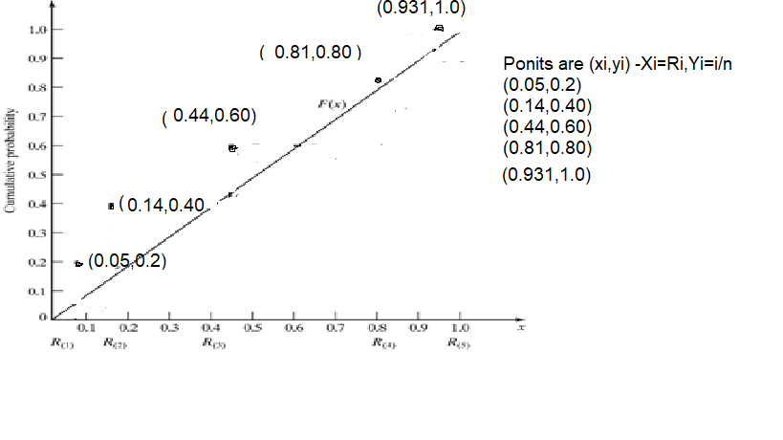


Slide 23
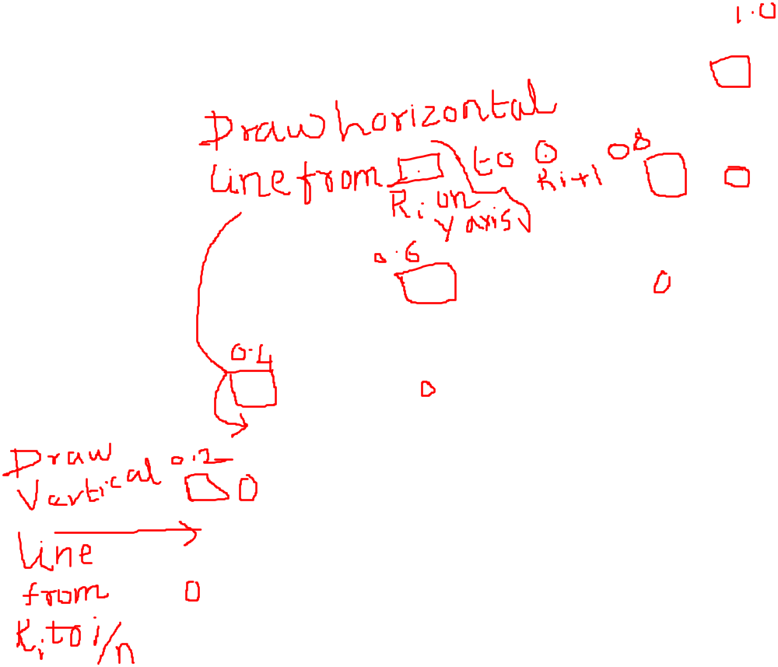
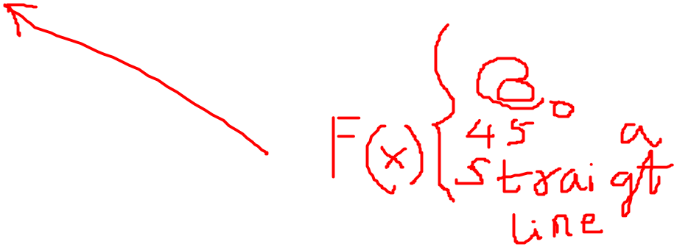

Slide 24
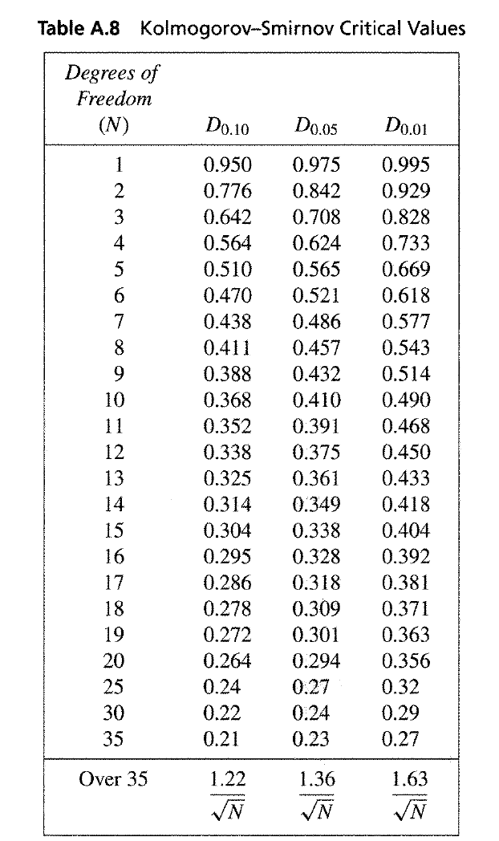

Slide 25
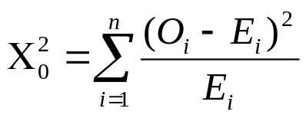
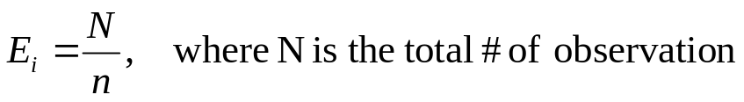
Chi-square test [Frequency Test]
Chi-square test uses the sample statistic:
  Approximately the chi-square distribution with n-1 degrees of freedom (where the critical values are tabulated in Table A.6)
  For the uniform distribution, E_{i}, the expected number in the each class is:
Valid only for large samples, e.g. N >= 50
n is the # of classes
E_{i} is the expected # in the i^{th} class
O_{i} is the observed # in the i^{th} class

Slide 26

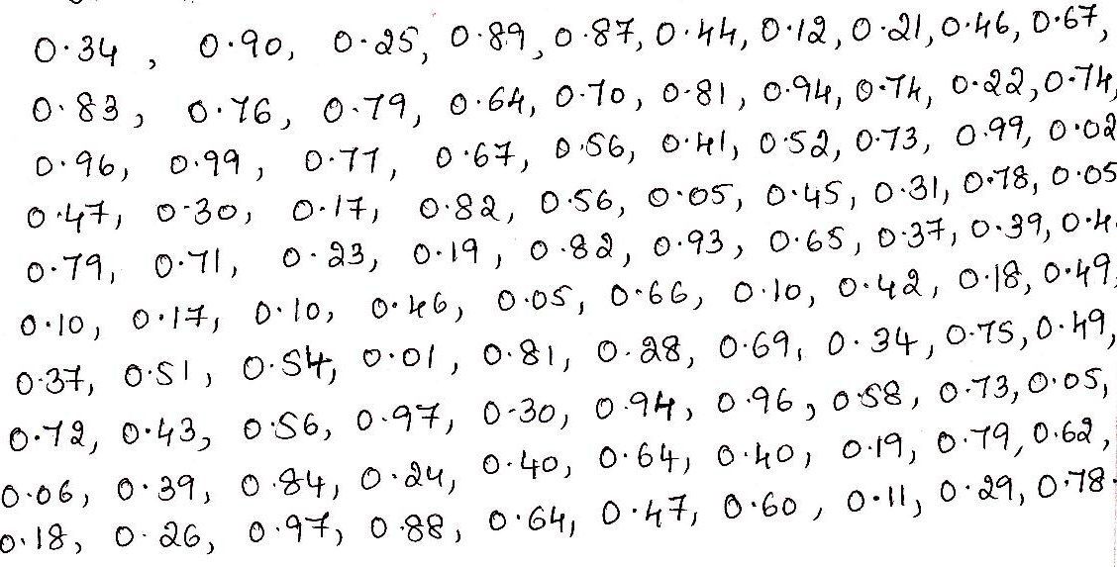
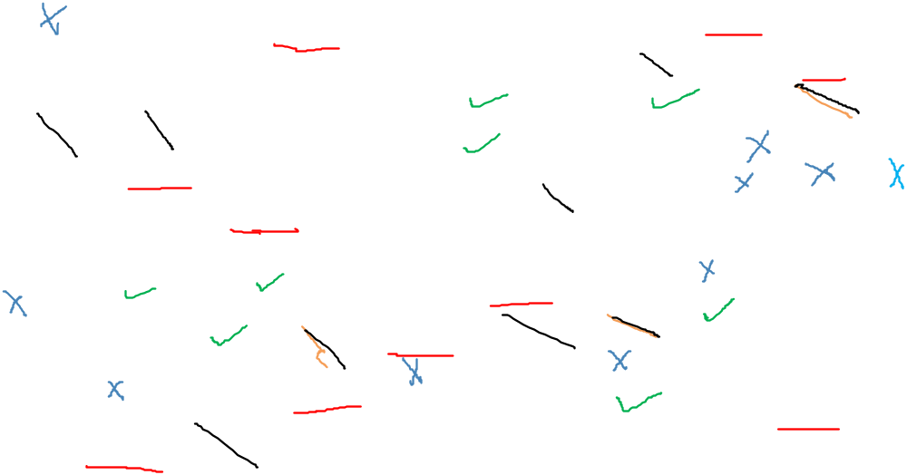






































Problem on Chi Square Test
Using Chi Square test with α = 0.05 find whether the sample data given below can be rejected or not.

Slide 27

Chi Square test Continuation
Range of Value 0.01 to 0.10
Numbers in the given sample falling in this range
0.02 ( 3rd Row last Value) 0.05 (4th Row 6th Value) 0.05 (4th Row last value) 0.10 0.10 0.05 0.10 (6th row 1st,3rd 5th and 7th values) 0.01(7th row 4th value) 0.05 (8th row last value) 0.06 (9th row first value)
Total = 10
So = 10
Similarly for 2nd Range 0.11 to 0.20 total square boxes are 8 So =8

Slide 28

Chi-Square goodness of fit Test
Interval | Range | O_{i} | E_{i} | O_{i} - E_{i} | (O_{i} - E_{i}) ² | (O_{i} - E_{i}) ² E_{i}
1 | [0.0,0.10) 0.01-0.10 | 10 | 10 | 0 | 0 | 0
2 | [0.1,0.20) 0.11-0.20 | 8 | 10 | -2 | 4 | 0.40
3 | [0.2,0.30) 0.21-0.30 | 10 | 10 | 0 | 0 | 0
4 | [0.3,0.40) 0.31-0.40 | 10 | 10 | 0 | 0 | 0
5 | [0.4,0.50) 0.41-0.50 | 11 | 10 | 1 | 1 | 0.10
6 | [0.5,0.60) 0.51-0.60 | 8 | 10 | -2 | 4 | 0.4
7 | [0.6,0.70) 0.61-0.70 | 10 | 10 | 0 | 0 | 0
8 | [0.7,0.80) 0.71-0.80 | 14 | 10 | 4 | 16 | 1.6
9 | [0.8,0.90) 0.81-0.90 | 10 | 10 | 0 | 0 | 0
10 | [0.9,1.0) 0.91-1.00 | 9 | 10 | -1 | 1 | 0.10
∑ |  | 100 | 100 | 0 |  | 2.6

Slide 29
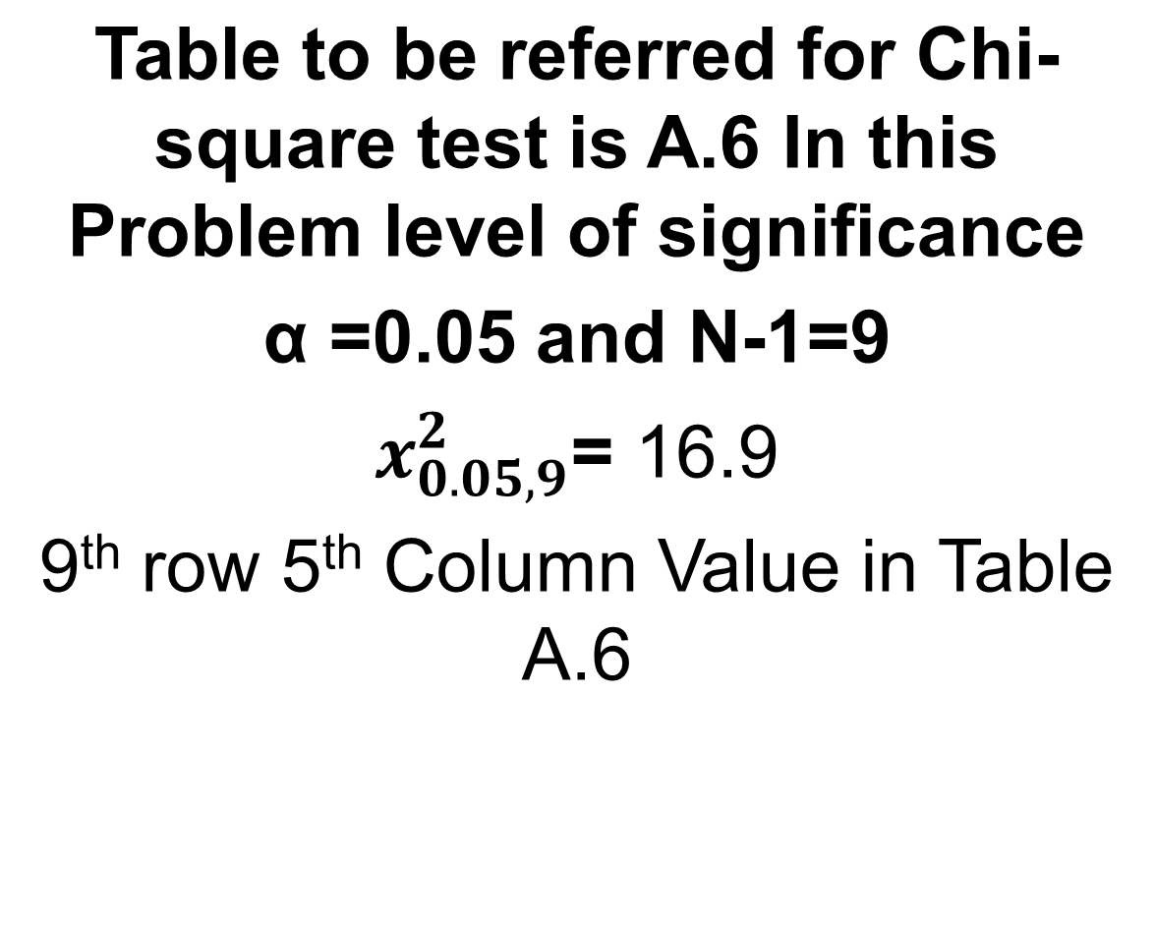

Slide 30
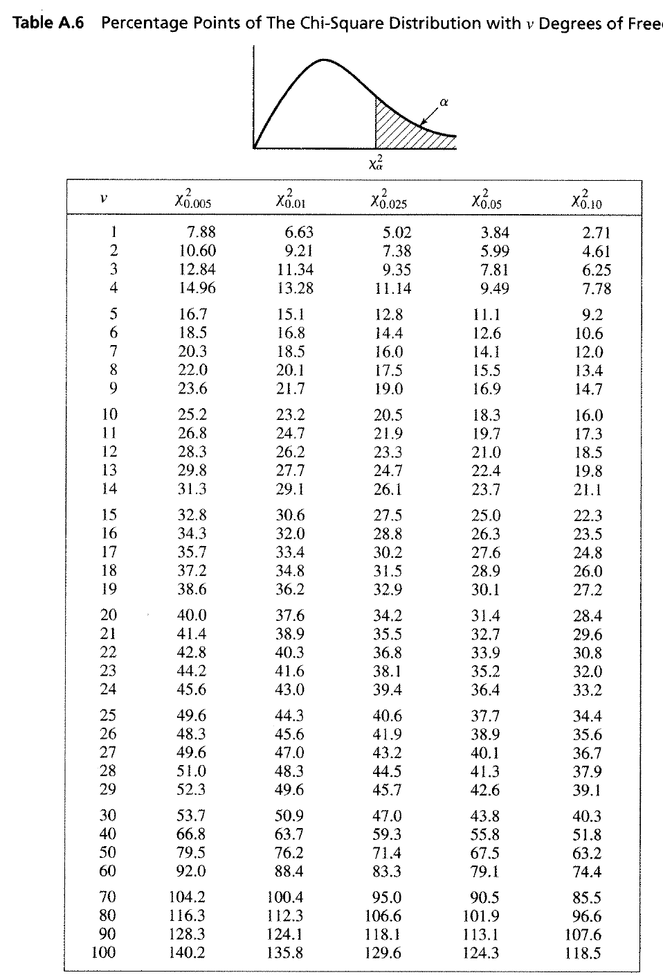


Slide 31

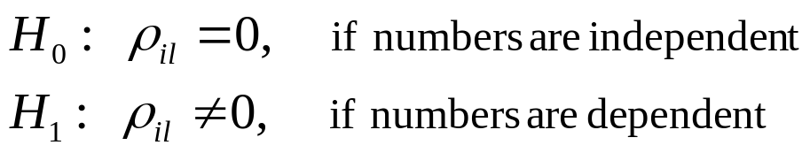

Tests for Autocorrelation [Tests for RN]
Testing the autocorrelation between every l numbers (l is a.k.a. the lag), starting with the i^{th} number
  The autocorrelation ρ_{il} between numbers: R_{i}, R_{i+l}, R_{i+2l}, R_{i+(M+1)l}
  M is the largest integer such that
Hypothesis:
If the values are uncorrelated:
  For large values of M, the distribution of the estimator of ρ_{im}, denoted is approximately normal.

Slide 32
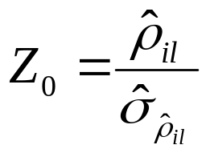
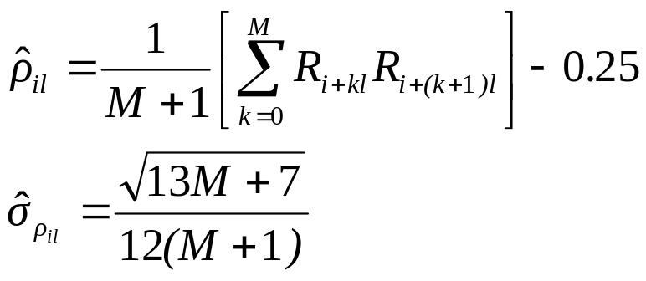
Tests for Autocorrelation [Tests for RN]
Test statistics is:
  Z₀ is distributed normally with mean = 0 and variance = 1, and:
If ρ_{il} > 0, the subsequence has positive autocorrelation
  High random numbers tend to be followed by high ones, and vice versa.
If ρ_{il} < 0, the subsequence has negative autocorrelation
  Low random numbers tend to be followed by high ones, and vice versa.

Slide 33
Data on page 309 from Text Book
0.12 0.01 0.23 0.28 0.89 0.31 0.64 0.28 0.83 0.93 0.99 0.15 0.33 0.35 0.91 0.41 0.60 0.27 0.75 0.88 0.68 0.49 0.05 0.43 0.95 0.58 0.19 0.36 0.69 0.87

Slide 34
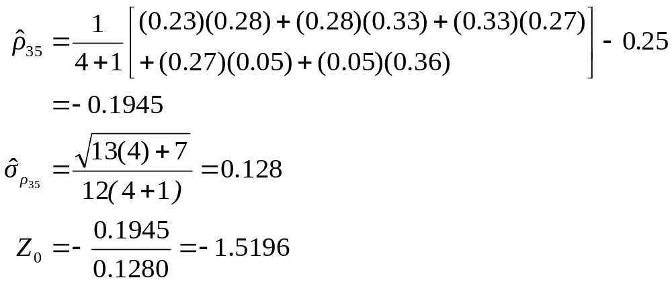
Example [Test for Autocorrelation]
Test whether the 3rd, 8th, 13th, and so on, for the following output on 309.
  Hence, α = 0.05, i = 3, l = 5, N = 30, and M = 4
  Calculation of M; M is the longest integer such that i+(M+1)l<=N
  3+(M+1)5=30; 3+5M+5= 30; M=(30-8)/5=4.4 Truncated integer=4
  From Table A.5, z_{0.025} = 1.96. Hence, the hypothesis is not rejected.

Slide 35
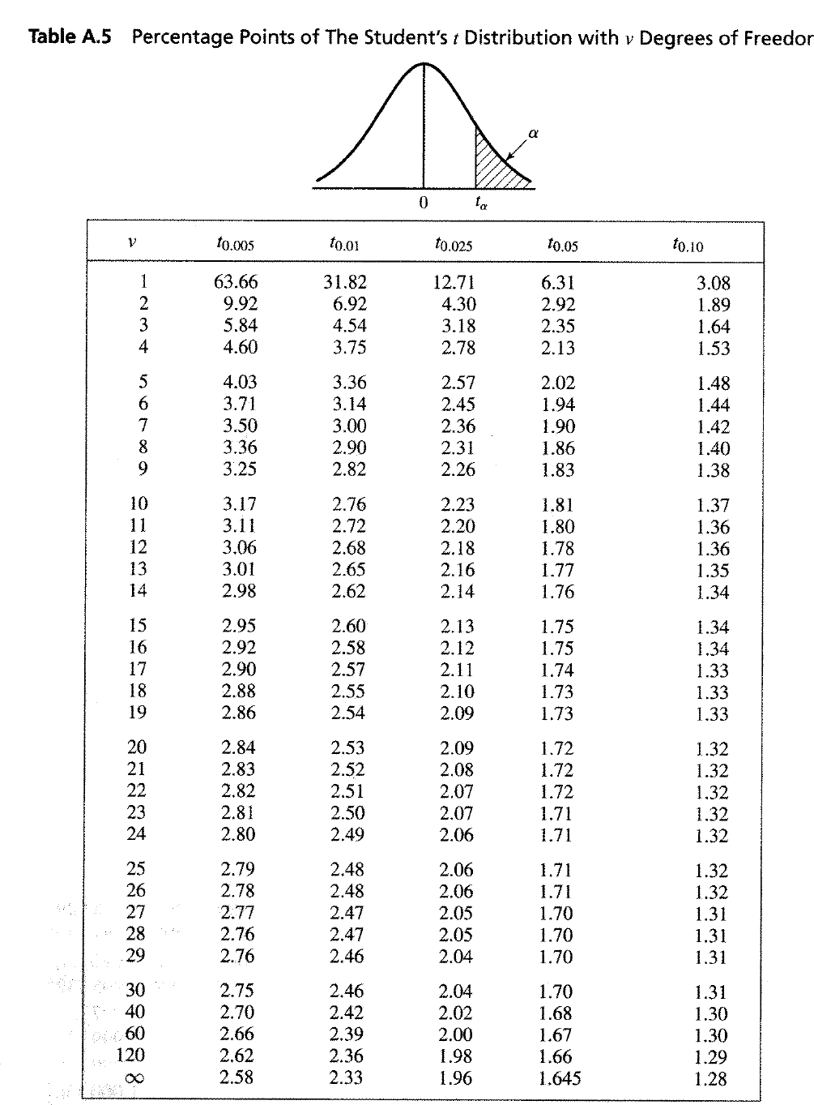


Slide 36
Shortcomings [Test for Autocorrelation]
The test is not very sensitive for small values of M, particularly when the numbers being tests are on the low side.
Problem when “fishing” for autocorrelation by performing numerous tests:
  If α = 0.05, there is a probability of 0.05 of rejecting a true hypothesis.
  If 10 independence sequences are examined,
    The probability of finding no significant autocorrelation, by chance alone, is 0.95¹⁰ = 0.60.
    Hence, the probability of detecting significant autocorrelation when it does not exist = 40%

Slide 37
Summary
In this chapter, we described:
  Generation of random numbers
  Testing for uniformity and independence
Caution:
  Even with generators that have been used for years, some of which still in used, are found to be inadequate.
  This chapter provides only the basic
  Also, even if generated numbers pass all the tests, some underlying pattern might have gone undetected.

